Slide 1
Strategic Planning Customer Education & Digital Content Development
Presenter: Marc Sodano
Notes:
Thank you for having me here. I appreciate the opportunity to meet you in person and exchange information, ask questions, and get the general feel of the culture here. I’m looking forward to the next hour with you

Slide 2
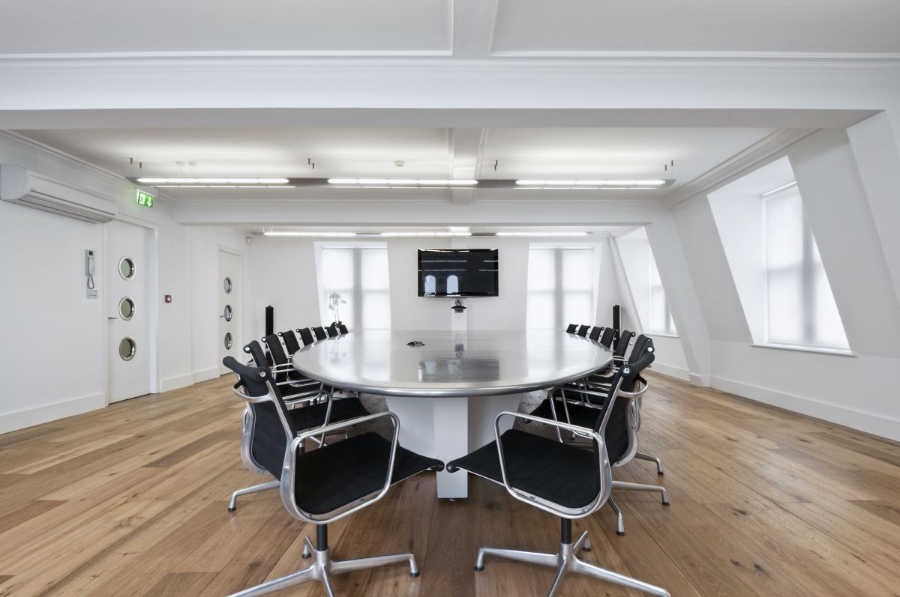
Agenda
Building a Chainalysis Academy Strategy
A robust premium offering for top-tier strategic customers
2 Technical Enhancements and improvements for exploration
2 Content Production Adjustments to explore
Notes:
The agenda is as follows – I would like to level set on what I heard your challenges to be from our brief conversations making sure we are on the same page. Second, I want to put a plug in for Training Services, why its important, and my view on priorities. Third, I will be detailing out how I build strategic education business plans that has worked for me numerous times in the past. My objective is to give you a very clear picture of what to expect the first 30 -60 -90 days, by using real examples. Next I will be addressing your challenges in detail with tested best practices and solutions, again by using real examples. Finally, I have two slides on previous transformations in case your interested. I do want to save some time for questions and answers. There are a good number of slides here, and I will be flying quickly through a few, while spending more time on others. My hope is that I will be finished by 1:45. Please feel free to stop me and ask for clarification or to tell me to move on if needed.

Slide 3
Building the Education Strategy 4 Phase Approach – Review Quarterly /Adjust Semiannually
Data Collection
Analysis & Evaluation
Building the Plan
Socialization and Deployment
Onboarding, Orientation, & Learning
Input from the field -Collecting Feedback
Collecting data and reports
Academy thorough inspection
Identify opportunities for improvement
Seek alignment with corporate goals and teams
Determine Key Initiatives
Lock in targets and time lines
Review with team and seek approvals
Present to wider audience
Initiative project plans with deadlines and ownership
Major Objective
Major Objective
Major Objective
Major Objective
Produce Balanced Scorecard
Produce Strategy Map
Collaborative Project Plans
Collect Present State Data
This slide is 100% editable. Adapt it to your needs and capture your audience's attention.
Notes:
A sound strategic plan starts with gathering information and asking questions to a wide audience so that a clear picture can be made of the Academy current state, and expectations for desired future state. Opportunities, gaps and key initiatives can be collaboratively determined with measurable KPIs.
A deep dive analysis and review of the business is critical to developing a solid GTM strategic plan. I very much like to build a scalable plan based on data, industry benchmarks, and my experience. The first 30 days is spent on reviewing the following information on these two slides
The Financials – I’m looking for trends and correlations, or anomalies. Normally there is a relationship between license sales and education revenues. The ratio can change depending on the circumstances. I also look for regional differences in relationship to our global business as a whole.
Routes to Market review lets me understand where our revenues are coming from both direct and indirect, and I can get a view into whether we are under utilizing a channel or how to direct our efforts optimizing it.
Competitive analysis give me a view on our breadth and depth of offerings, pricing, and reach in the market. The benchmarking provides a baseline from which to compare. I do know, from TSIA benchmarks, Service focused companies have higher education growth rates than product focuses for example.

Slide 4
Building Academy Strategy Plan
Curriculum Review
01
All modalities and formats, eLearning, VILT, Certification etc.
Executive Plan Alignment
Ensure alignment to corporate and department goals
08
02
Certification Review
Development, delivery, test banks, reliability and security.
People
Analysis & Evaluation
8-point inspection of key areas
Provide scorecard for current state
Skill reviews, goal reviews, education and growth plans
07
03
LMS & Apps
Features, integrations, good/bad/ugly
Teams Alignment
Training delivery collaboration, CSM feedback loop, Support Incident reviews, Product team release cycles
06
04
Development Process Review
Communication Review
05
Efficiencies, opportunities to streamline,
Vocabulary alignment, Team cadence, status reports, goal reviews, clarity
Notes:
A sound strategic plan starts with gathering information and asking questions to a wide audience so that a clear picture can be made of the Academy current state, and expectations for desired future state. Opportunities, gaps and key initiatives can be collaboratively determined with measurable KPIs.
A deep dive analysis and review of the business is critical to developing a solid GTM strategic plan. I very much like to build a scalable plan based on data, industry benchmarks, and my experience. The first 30 days is spent on reviewing the following information on these two slides
The Financials – I’m looking for trends and correlations, or anomalies. Normally there is a relationship between license sales and education revenues. The ratio can change depending on the circumstances. I also look for regional differences in relationship to our global business as a whole.
Routes to Market review lets me understand where our revenues are coming from both direct and indirect, and I can get a view into whether we are under utilizing a channel or how to direct our efforts optimizing it.
Competitive analysis give me a view on our breadth and depth of offerings, pricing, and reach in the market. The benchmarking provides a baseline from which to compare. I do know, from TSIA benchmarks, Service focused companies have higher education growth rates than product focuses for example.

Slide 5
01
Academy Review – Thorough Inspection
Digital Curriculum Review
Products: Curriculum Review | Industry Benchmarks
Personas and paths, customer roadmap, customer sat, course completion, lab completion, attendance, pricing, competitive landscape, maintenance | Alignment - Content roles aligned to customer roadmap? Engagement -Above 90% completion rates?
Development process, ADDIE guidelines, SME alignment | Efficient development ratio :20 hours of develop time per 1 hour of delivery time? Design document with approvals?
Alignment to product rollouts Content format and location | Course maintenance and cycles? Version control, searchable content management processes?
Competitive markets, pricing, SMB, Enterprise offerings | Pricing model that is scalable, easy to factor international pricing, and volume discounts
Notes:
In a study done by IDC MarketScape, over 500 IT projects were analyzed by 212 IT managers who identified training and team skills to be the most significant factor on the overall the success of the project. Enablement is key to driving customer satisfaction, ROI, and customer loyalty. Moreover, the study shows that untrained customers require 6X more support than trained customers.

Slide 6
Academy Review – Thorough Inspection
Certification Review
02
Product: Certification Review | Industry Benchmarks
Certification – pass/fail rates, course attendance to cert ratio, test reliability, | Certification to course reliability – 80% pass baseline? Test security & rotating test banks?
Service Quality Levels – Services NPS scores, Support ticket resolutions, Certification competency levels | Certification and Channel alignment? Support burden & ticket review?
Certification brand awareness | Marketing rankings and cross market relationships
Notes:
In a study done by IDC MarketScape, over 500 IT projects were analyzed by 212 IT managers who identified training and team skills to be the most significant factor on the overall the success of the project. Enablement is key to driving customer satisfaction, ROI, and customer loyalty. Moreover, the study shows that untrained customers require 6X more support than trained customers.

Slide 7
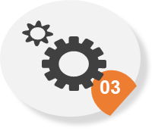
Academy Review – Thorough Inspection
LMS and Applications
LMS & Application: Review | Industry Benchmarks
Academy web page, product bundling, ecommerce capabilities, | Key word or meta character search CC Process, Subscriptions and bundles, foreign currency capabilities
Lab integrations, collaboration tool integrations, certification integrations | Labs and LMS integrated, launches with no delays Instructor can control breakout rooms and appoint speakers Digital badging
Sales and marketing leads integrations | Marketing leads integrations with Hubspot, Salesforce, Marketo?
Customer Success integrations tracking customer onboarding and statistics | CX integration with Gainsight, Planhat, tracking adoption, and TTV?
Notes:
In a study done by IDC MarketScape, over 500 IT projects were analyzed by 212 IT managers who identified training and team skills to be the most significant factor on the overall the success of the project. Enablement is key to driving customer satisfaction, ROI, and customer loyalty. Moreover, the study shows that untrained customers require 6X more support than trained customers.

Slide 8
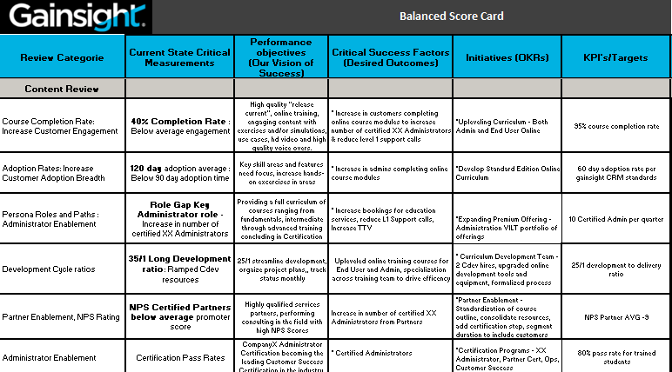
Academy Review – Thorough Inspection
Scorecard & Strategy Map Results
Notes:
In a study done by IDC MarketScape, over 500 IT projects were analyzed by 212 IT managers who identified training and team skills to be the most significant factor on the overall the success of the project. Enablement is key to driving customer satisfaction, ROI, and customer loyalty. Moreover, the study shows that untrained customers require 6X more support than trained customers.

Slide 9

Academy Strategy Map
Mission
Enable our customers and ensure their success with Aqua products, including but not limited to development of Aquarians, communities and partnership ecosystems
Develop Customer enablement paths to accelerate adoption | Build a world of aqua professionals | Develop Partner enablement portfolio | Increase customers purchasing training growing revenues
Strategic Priorities
Strategic Results
Strategic Initiatives
KPI Targets
Up-level Level I Curriculum
Digital Adoption Content Development
Hands-on Labs with Self-paced Learning
Faster Value Realization (TTV) Reduce Support Burden -Fewer Training Related Support Calls
Increasing number of Aqua Certified professionals
Increase Brand Recognition (CNAPP) Drive Partner Delivery Quality NPS
Maximize efficiency and decision making based on data Create an empowering workplace
TBD
TBD
TBD
TBD
Develop Administrator Curriculum Path
Aqua Administrator Certification
Advanced Curriculum CNAPP Certification
Large Scale Partner Certification Program
Academy Program for Universities
LMS Selection and Implementation
Social Learning Implementation

Slide 10
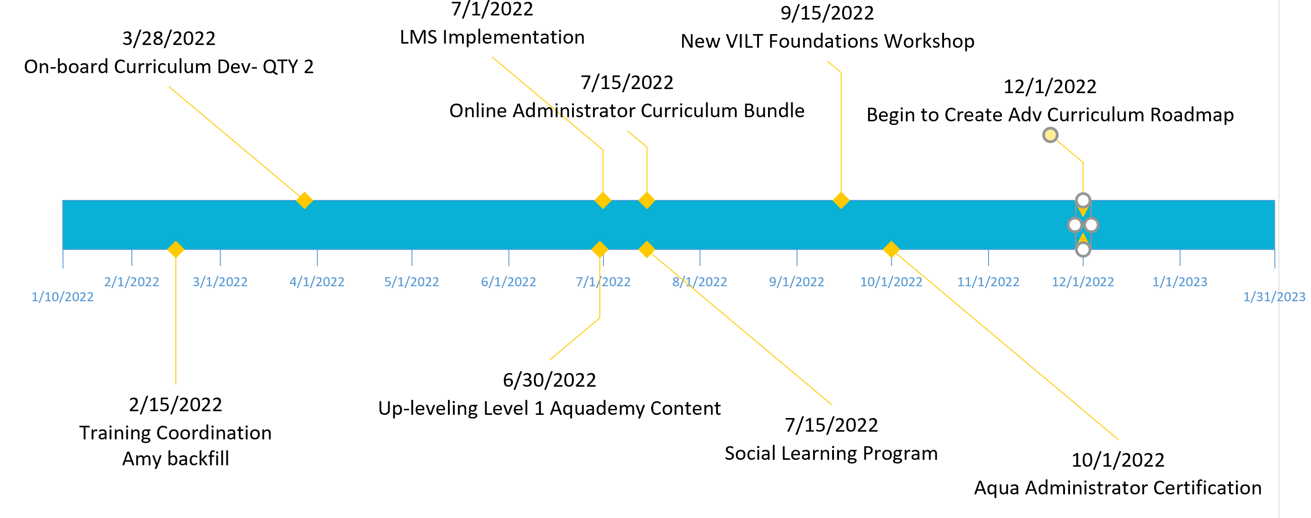

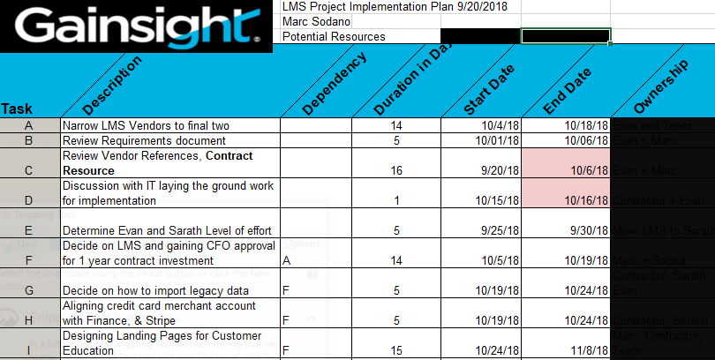
Academy Timelines and Project Plans
Socialization and Deployment:
Accurate Timeline for Initiatives
Detailed Project plans with ownership (Asana)
Team collaboration and tracking

Slide 11
Agenda
Building a Chainalysis Academy Strategy
A robust premium offering for top-tier strategic customers
2 Technical Enhancements and improvements for exploration
2 Content Production Adjustments to explore
Notes:
The agenda is as follows – I would like to level set on what I heard your challenges to be from our brief conversations making sure we are on the same page. Second, I want to put a plug in for Training Services, why its important, and my view on priorities. Third, I will be detailing out how I build strategic education business plans that has worked for me numerous times in the past. My objective is to give you a very clear picture of what to expect the first 30 -60 -90 days, by using real examples. Next I will be addressing your challenges in detail with tested best practices and solutions, again by using real examples. Finally, I have two slides on previous transformations in case your interested. I do want to save some time for questions and answers. There are a good number of slides here, and I will be flying quickly through a few, while spending more time on others. My hope is that I will be finished by 1:45. Please feel free to stop me and ask for clarification or to tell me to move on if needed.

Slide 12
Platinum Academy Offering
Blended Learning Model Offering
On-Demand
Live Training
Certification On-Demand
eLearning On-Demand
Instructor-led
Virtual Classroom
Dedicated/On-site
Adoption Tool Kit Premium offering for top tier enterprise accounts that have:
Evolving processes
Fluid workforce
Job role changes
Premium Offering
Adoption Kits
Custom Content
Adoption Services
Notes:
A sound strategic plan starts with gathering information and asking questions to a wide audience so that a clear picture can be made of the Academy current state, and expectations for desired future state. Opportunities, gaps and key initiatives can be collaboratively determined with measurable KPIs.
A deep dive analysis and review of the business is critical to developing a solid GTM strategic plan. I very much like to build a scalable plan based on data, industry benchmarks, and my experience. The first 30 days is spent on reviewing the following information on these two slides
The Financials – I’m looking for trends and correlations, or anomalies. Normally there is a relationship between license sales and education revenues. The ratio can change depending on the circumstances. I also look for regional differences in relationship to our global business as a whole.
Routes to Market review lets me understand where our revenues are coming from both direct and indirect, and I can get a view into whether we are under utilizing a channel or how to direct our efforts optimizing it.
Competitive analysis give me a view on our breadth and depth of offerings, pricing, and reach in the market. The benchmarking provides a baseline from which to compare. I do know, from TSIA benchmarks, Service focused companies have higher education growth rates than product focuses for example.

Slide 13
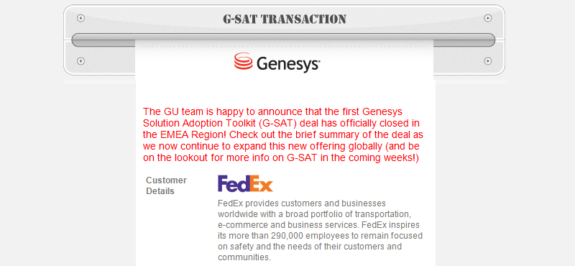

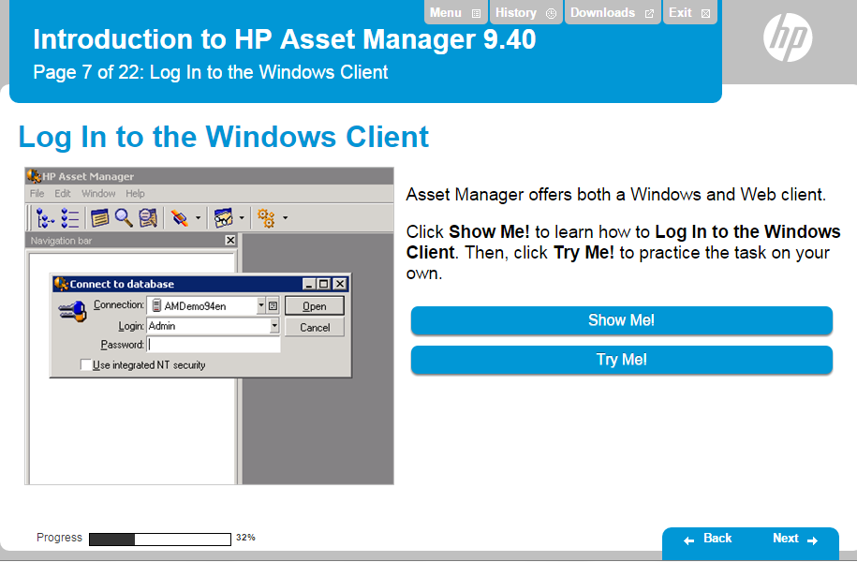
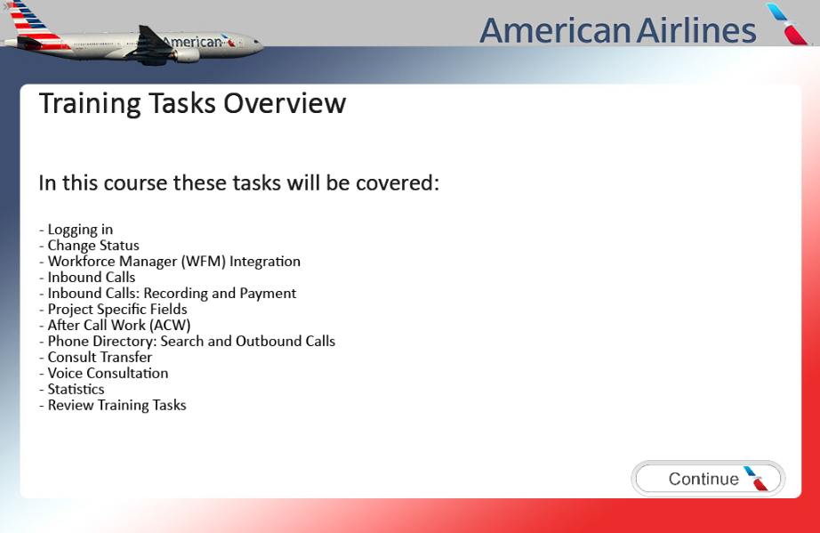

Premier Offering for Top Tier Customers Adoption Tool Kit
What is the deliverable:
Bundled Content: Customizable Solution including eLearning, dedicated VILT go-live-readiness, certification exams, with exam prep.
Branded, localized and packaged to implement on client LMS or web server Re-branding the look and feel to documenting your organization’s unique procedures
Exercises & Simulations (Show/Practice/Test) based on client’s custom configuration
How to build:
Using customizable Articulate templates
Using third party hosting applications
Using LMS Domains/Panoramas/Portals

Slide 14

Platinum Academy Offering Adoption Tool Kit
Pricing derived from two models
Cost Plus 35% margin pricing: bottoms up approach
Development hours * hourly development labor rate + 1 year maintenance costs
Training Pricing : top-down approach
Number of personas * consumption averages * hourly course rate * volume discount
Genesys GSAT Pricing started at $35,500
10 Users, 2 Managers, 1 Administrator
HP ART License Pricing started at $50,000
Per product line, user cap, Included support contract
Notes:
I did take a few notes while speaking to most of you, and this is what I could pull from them. I believe there were a few others, but I thought to pair it down to a sample that I could address in the time allotted.

Slide 15
Agenda
Building a Chainalysis Academy Strategy
A robust premium offering for top-tier strategic customers
2 Technical Enhancements and improvements for exploration
2 Content Production Adjustments to explore
Notes:
The agenda is as follows – I would like to level set on what I heard your challenges to be from our brief conversations making sure we are on the same page. Second, I want to put a plug in for Training Services, why its important, and my view on priorities. Third, I will be detailing out how I build strategic education business plans that has worked for me numerous times in the past. My objective is to give you a very clear picture of what to expect the first 30 -60 -90 days, by using real examples. Next I will be addressing your challenges in detail with tested best practices and solutions, again by using real examples. Finally, I have two slides on previous transformations in case your interested. I do want to save some time for questions and answers. There are a good number of slides here, and I will be flying quickly through a few, while spending more time on others. My hope is that I will be finished by 1:45. Please feel free to stop me and ask for clarification or to tell me to move on if needed.

Slide 16

Technical Enhancements for Exploration
Challenges
Instruqt Solution
On Boarding Customers
eLearning with hands-on labs
they want and need more hands-on in small digestible chunks of training.
Instruqt embeds labs into online courses providing each student step by steps instructions.
CSM Skill Enhancement
Micro hands-on courses
Cloud Lab Tool Integration
Guide Users Through New & Underused Features
Personalized Customer Onboarding
Streamline Operations
Customize and Scale
Customer Success managers need to strengthen their technical skills in small bite size consumable chunks.
Create custom course paths for CRMs. Easy to consume and track progress
Lab Complexity
Hot Sites and Containers
Dependent on IT for complex lab processes and overhead, not scalable
Lab loads in 30 seconds and every student has dedicated full platform
Custom Labs
Easy to Configure
Creating custom-made labs for workshops problematic. Customer sandboxes, and large-scale hands-on tech conferences difficult to setup
Text editor easy to use, exercise validity checks and completion tracking
Notes:
A sound strategic plan starts with gathering information and asking questions to a wide audience so that a clear picture can be made of the Academy current state, and expectations for desired future state. Opportunities, gaps and key initiatives can be collaboratively determined with measurable KPIs.
A deep dive analysis and review of the business is critical to developing a solid GTM strategic plan. I very much like to build a scalable plan based on data, industry benchmarks, and my experience. The first 30 days is spent on reviewing the following information on these two slides
The Financials – I’m looking for trends and correlations, or anomalies. Normally there is a relationship between license sales and education revenues. The ratio can change depending on the circumstances. I also look for regional differences in relationship to our global business as a whole.
Routes to Market review lets me understand where our revenues are coming from both direct and indirect, and I can get a view into whether we are under utilizing a channel or how to direct our efforts optimizing it.
Competitive analysis give me a view on our breadth and depth of offerings, pricing, and reach in the market. The benchmarking provides a baseline from which to compare. I do know, from TSIA benchmarks, Service focused companies have higher education growth rates than product focuses for example.

Slide 17
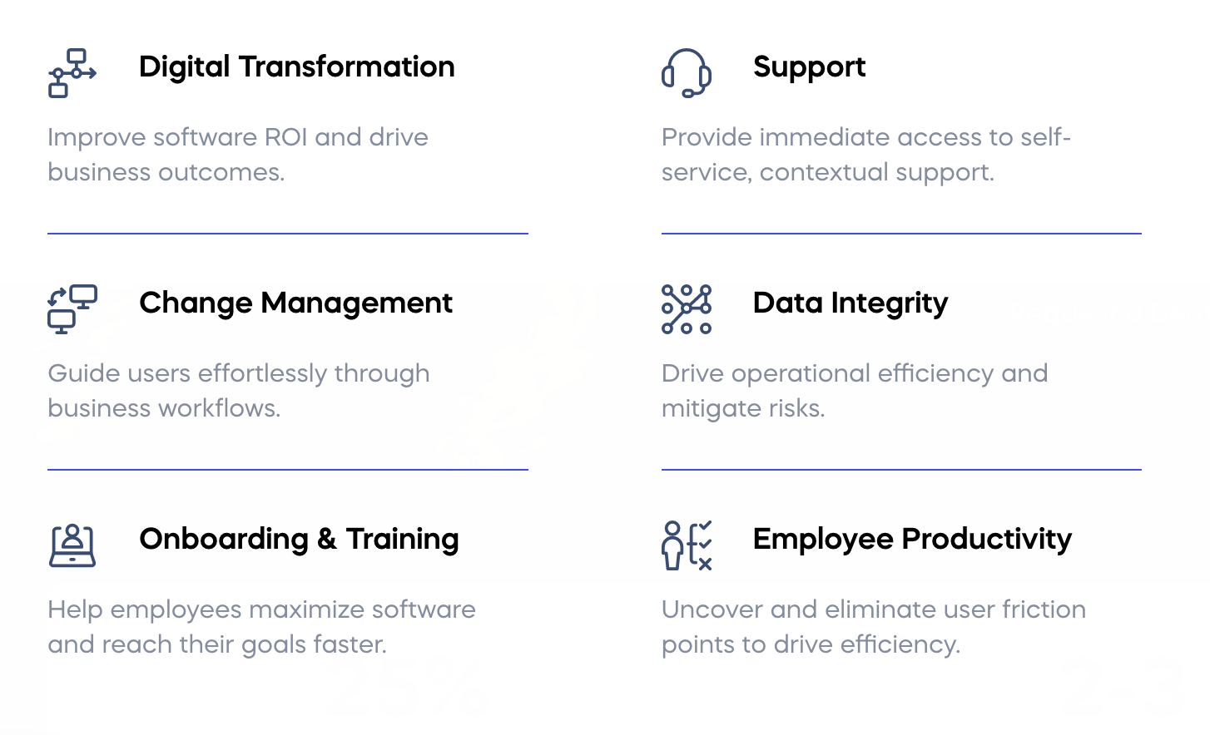



Technical Enhancements for Exploration In App Training : Digital Adoption Tools
In application adoption tools provide micro enablement and collect user experience data:
Measure and Optimize user experience with adoption tools
Context sensitive videos lead customers through workflows
Statistical analysis reveals where customers have onboarding problems
Areas of Impact
Solutions

Slide 18
Agenda
Building a Chainalysis Academy Strategy
A robust premium offering for top-tier strategic customers
2 Technical Enhancements and improvements for exploration
2 Content Production Adjustments to explore
Notes:
The agenda is as follows – I would like to level set on what I heard your challenges to be from our brief conversations making sure we are on the same page. Second, I want to put a plug in for Training Services, why its important, and my view on priorities. Third, I will be detailing out how I build strategic education business plans that has worked for me numerous times in the past. My objective is to give you a very clear picture of what to expect the first 30 -60 -90 days, by using real examples. Next I will be addressing your challenges in detail with tested best practices and solutions, again by using real examples. Finally, I have two slides on previous transformations in case your interested. I do want to save some time for questions and answers. There are a good number of slides here, and I will be flying quickly through a few, while spending more time on others. My hope is that I will be finished by 1:45. Please feel free to stop me and ask for clarification or to tell me to move on if needed.

Slide 19

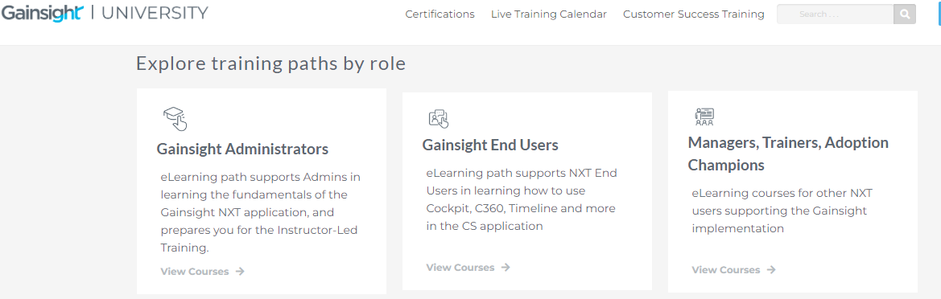
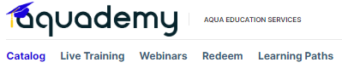
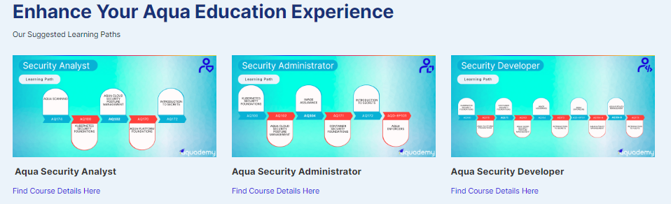

Digital Content Production Adjustments for Exploration Learning Paths : Role based Curriculum
Where do I Start:
Identify personas, analyze skill requirements, and competency levels
Drives branding, creates company champions on a global scale:
Combine with Certification
Integrate with Channel Program for Partners
Useful for Academy programs
Useful for Support, PS, and CS enablement

Slide 20
Content Production Adjustments for Exploration
Streamline and Scale
PM Benefits
Collaborative Project Management System
Assign ownership, track and communicate across groups
Systems: Asana, MS Project
CMS Benefits:
Collaborative Content Management System
Get Organized- Specific repositories by persona path/competency level
Collaborate with Documentation team and Cross reference
Meta-data search capabilities, Version control, document sharing, Co-authoring, Security, Enhanced work-flow
Systems : Drupal (open source), SharePoint, Contentful
Streamline maintenance - push out updates
Deliver on time, reduce stress and ambiguity
Streamline and Scale
Structured Content Management
Collaborative Project Management
Notes:
A sound strategic plan starts with gathering information and asking questions to a wide audience so that a clear picture can be made of the Academy current state, and expectations for desired future state. Opportunities, gaps and key initiatives can be collaboratively determined with measurable KPIs.
A deep dive analysis and review of the business is critical to developing a solid GTM strategic plan. I very much like to build a scalable plan based on data, industry benchmarks, and my experience. The first 30 days is spent on reviewing the following information on these two slides
The Financials – I’m looking for trends and correlations, or anomalies. Normally there is a relationship between license sales and education revenues. The ratio can change depending on the circumstances. I also look for regional differences in relationship to our global business as a whole.
Routes to Market review lets me understand where our revenues are coming from both direct and indirect, and I can get a view into whether we are under utilizing a channel or how to direct our efforts optimizing it.
Competitive analysis give me a view on our breadth and depth of offerings, pricing, and reach in the market. The benchmarking provides a baseline from which to compare. I do know, from TSIA benchmarks, Service focused companies have higher education growth rates than product focuses for example.

Slide 21
Summary
Building an Academy Strategy
4 Phases, Current State Analysis, Scorecard, Strategy Map, Project Plans
A robust premium offering for top-tier strategic customers
Adoption Tool Kit, Customized Content
Technical Enhancements and improvements for exploration
Hands on labs, Digital Adoption Tools
Content Production Adjustments to explore
Personas, Role based content, Content and Project Management Systems
Notes:
The agenda is as follows – I would like to level set on what I heard your challenges to be from our brief conversations making sure we are on the same page. Second, I want to put a plug in for Training Services, why its important, and my view on priorities. Third, I will be detailing out how I build strategic education business plans that has worked for me numerous times in the past. My objective is to give you a very clear picture of what to expect the first 30 -60 -90 days, by using real examples. Next I will be addressing your challenges in detail with tested best practices and solutions, again by using real examples. Finally, I have two slides on previous transformations in case your interested. I do want to save some time for questions and answers. There are a good number of slides here, and I will be flying quickly through a few, while spending more time on others. My hope is that I will be finished by 1:45. Please feel free to stop me and ask for clarification or to tell me to move on if needed.

Slide 22

Questions and Answers
Thank You
Questions?
Email: Msodano@Fastmail.FM

Slide 23
Extra Slides
Marc Sodano
Notes:
Thank you for having me here. I appreciate the opportunity to meet you in person and exchange information, ask questions, and get the general feel of the culture here. I’m looking forward to the next hour with you

Slide 24
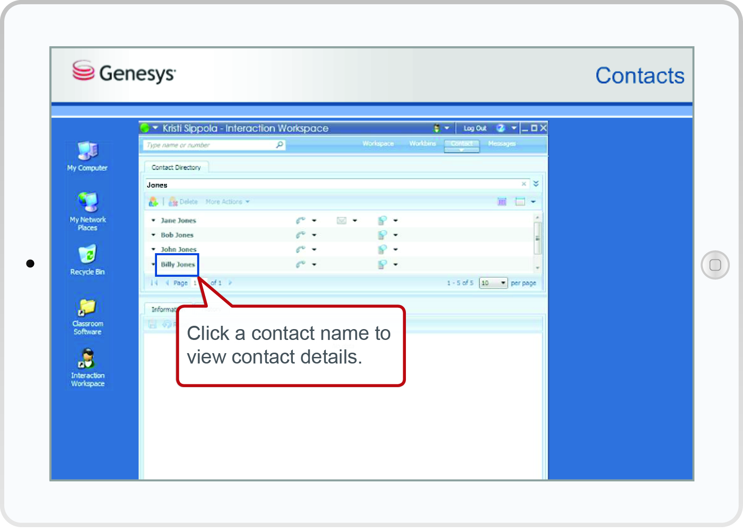
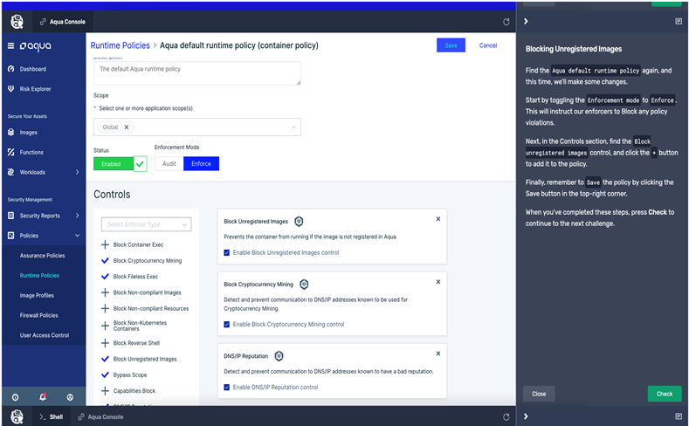
Building and Scaling out Aqua Level 2 Administrator Roadmap Hands-on Lab within Self-paced example: Vendor name Instruqt
TRAINING + HANDS-ON PRACTICE + KNOWLEDG CHECKS = LEARNING
On demand and in control of your training schedule
Engaging content, step by step module-based instructions
Hands-on Labs reinforcing training and building your skills
Bundled with Administrator certification voucher
Notes:
This is an actual example of how it works. A vendor, called Instruqt provided the lab.
As you can see our platform loads quickly at the press of a button, the instructions are to the right, the platform is to the left.
The Proof of concept was seamless.

Slide 25
Building 3/6/12 Academy Strategy First 3 Months – Absorb, Analyze, Design, Socialize, Deploy
30 days
Learning, data collection and analysis
60 days
Planning, Design and collaboration
90 days
Socialization , Approvals and deployment
Deliverables:
Data Analytics – Decisions based on current data NPS, completion rates, course completion, cert pass ratios, etc.
Strategy Map – Priorities, initiatives aligned to executive goals, Key KPI goals
Project Plan – Collaborative PM tool, and Deliverable Timeline
Notes:
A sound strategic plan starts with gathering information and asking questions to a wide audience so that a clear picture can be made of the Academy current state, and expectations for desired future state. Opportunities, gaps and key initiatives can be collaboratively determined with measurable KPIs.
A deep dive analysis and review of the business is critical to developing a solid GTM strategic plan. I very much like to build a scalable plan based on data, industry benchmarks, and my experience. The first 30 days is spent on reviewing the following information on these two slides
The Financials – I’m looking for trends and correlations, or anomalies. Normally there is a relationship between license sales and education revenues. The ratio can change depending on the circumstances. I also look for regional differences in relationship to our global business as a whole.
Routes to Market review lets me understand where our revenues are coming from both direct and indirect, and I can get a view into whether we are under utilizing a channel or how to direct our efforts optimizing it.
Competitive analysis give me a view on our breadth and depth of offerings, pricing, and reach in the market. The benchmarking provides a baseline from which to compare. I do know, from TSIA benchmarks, Service focused companies have higher education growth rates than product focuses for example.

Slide 26
Building Academy Strategy Current State Thorough Inspection – Key Areas
Curriculum Review
01
This slide is 100% attention.
Executive Plan Alignment
This slide is 100% editable.
08
02
Certification Review
This slide is 100% audience's attention.
People
This slide is 100% editable.
Adapt it to your
07
03
LMS & Apps
This slide is 100% editable.
Teams Alignment
This slide is 100% editable.
Adapt it to your
06
04
Development Process Review
Communication Review
05
This slide is 100% editable.
This slide is 100% editable.
Adapt it to your
Notes:
A sound strategic plan starts with gathering information and asking questions to a wide audience so that a clear picture can be made of the Academy current state, and expectations for desired future state. Opportunities, gaps and key initiatives can be collaboratively determined with measurable KPIs.
A deep dive analysis and review of the business is critical to developing a solid GTM strategic plan. I very much like to build a scalable plan based on data, industry benchmarks, and my experience. The first 30 days is spent on reviewing the following information on these two slides
The Financials – I’m looking for trends and correlations, or anomalies. Normally there is a relationship between license sales and education revenues. The ratio can change depending on the circumstances. I also look for regional differences in relationship to our global business as a whole.
Routes to Market review lets me understand where our revenues are coming from both direct and indirect, and I can get a view into whether we are under utilizing a channel or how to direct our efforts optimizing it.
Competitive analysis give me a view on our breadth and depth of offerings, pricing, and reach in the market. The benchmarking provides a baseline from which to compare. I do know, from TSIA benchmarks, Service focused companies have higher education growth rates than product focuses for example.

Slide 27
Academy Review – Thorough Inspection
Development Process
04
04
Development Process Review | Industry Benchmarks
Product group alignment, field input on content creation. | Product release meetings and attendance? Course Ideation – Cross matrix input on roadmap?
Customer Experience analytics – Time to value, adoption tracking and calculations. | Customer Time to value equation, tracking and estimates? Customer Adoption tracking estimates?
Onboarding plans customers, partners | SMB vs Enterprise onboarding CRM and Education alignment
Notes:
In a study done by IDC MarketScape, over 500 IT projects were analyzed by 212 IT managers who identified training and team skills to be the most significant factor on the overall the success of the project. Enablement is key to driving customer satisfaction, ROI, and customer loyalty. Moreover, the study shows that untrained customers require 6X more support than trained customers.

Slide 28
Technical Enhancements for Exploration Hands-on Micro Learning with Instruqt
Aqua Challenges
Onboarding Customers - they want and need more hands-on micro training opportunities?
CRM Technical Skill building - Customer Success managers need to strengthen their technical skills in small bite size consumable chunks.
Lab Overhead and delays- Dependent on IT for complex lab processes and overhead, not scalable.
Creating custom-made labs for workshops problematic. Customer sandboxes, and large-scale hands-on tech conferences too difficult to setup.
Solution - Instruqt Cloud lab Provider (Integration with SkillJar!)
Significantly reduce lab overhead, delays, and complexity
Personalized Customer Onboarding - Accelerate time to value and speed implementation using hands-on interactive training on real-world scenarios
Guide Users Through New & Underused Features
Customized workshops for enterprise accounts and scalable for large events
Notes:
A deep dive analysis and review of the business is critical to developing a solid GTM strategic plan. I very much like to build a scalable plan based on data, industry benchmarks, and my experience. The first 30 days is spent on reviewing the following information on these two slides
The Financials – I’m looking for trends and correlations, or anomalies. Normally there is a relationship between license sales and education revenues. The ratio can change depending on the circumstances. I also look for regional differences in relationship to our global business as a whole.
Routes to Market review lets me understand where our revenues are coming from both direct and indirect, and I can get a view into whether we are under utilizing a channel or how to direct our efforts optimizing it.
Competitive analysis give me a view on our breadth and depth of offerings, pricing, and reach in the market. The benchmarking provides a baseline from which to compare. I do know, from TSIA benchmarks, Service focused companies have higher education growth rates than product focuses for example.

Slide 29
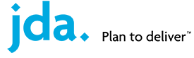
Optimizing Team Unity and Collaboration Transformational Leadership
Setting High Expectations, Support and Recognition
Quarterly reviews, tying plan to bonus program, All Hands Quarterly Rewards , Yearly Star Awards
Creating the Vision, encouragement and team building
Aligning Business Plan to Company Initiatives – “Innovation, Customer Experience” represented in a journey illustration for team to keep on hand
Quarterly management f2f meetings, reviewing progress, recognition and celebrating success

Slide 30
Example Customized Content - HP Adoption Readiness Tool

Slide 31
Optimizing Team Unity and Collaboration Transformational Leadership
Building Trust and Respect
Personal Role Reviews- Understanding employee commitment, and productivity
Weekly 1:1 Meetings with my directs – personal time for their feedback
Weekly LT meetings for team topics and resolution
Collaboration and Communication
Building the Business Plan together – Getting feedback, new ideas, opinions, setting clear expectations
Department Weekly email Reports – Keeps entire Education Services connected, helps build support for department challenges, repeat successes and not failures, builds appreciation for teams tasks

